Slide 1
6G4Z0024 Web Development Lecture 5: RESTful APIs and Dynamic Pages with JS
Ashley Williams
ashley.williams@mmu.ac.uk

Slide 2
Learning Objectives
To understand key concepts of RESTful APIs and how RESTful APIs work.
To understand how to interact with REST APIs using JavaScript
Be familiar with alternatives to RESTful APIs.

Slide 3
Unit Structure
# | W/C | Lecture | Lab
1 | 24/1/22 | Intro to the Unit; History; How the web works; Intro to HTML | Basic HTML
2 | 31/1/22 | HTML Forms; Intro to CSS | HTML Forms; Basic CSS
3 | 7/2/22 | Layouts with HTML and CSS; Responsiveness; Intro to JS | CSS Layouts; Basic JS
4 | 14/2/22 | JS for performing basic tasks | Working with JS
5 | 21/2/22 | REST APIs; Dynamic pages with JS | Sending/Receiving HTTP requests with JS
6 | 28/2/22 | Assignment; Next Steps | Assignment Support

Slide 4
Last week recap
Expanding on our JS skillset
Looking at form validation with Regular Expressions

Slide 5
Questions?

Slide 6
Recap: what is a client-server architecture?

Slide 7
Recap: what is HTTP?

Slide 8
What is a API?

Slide 9
What is an API?
Application Programming Interface
Allows different software systems to interact with each other
Defines how communication is exchanged between the different systems

Slide 10
What is a REST API?

Slide 11
What is an RESTful API?
Representational State Transfer
Client makes a call to a server, and receives data back – just like with the web…
REST APIs use HTTP methods for requests
Typically use JSON or XML for sending data

Slide 12
A closer look at HTTP
When we request a page from the web through the browser, we are pulling the information from a server somewhere on the internet
A DNS service will translate the readable URL to some IP address. The request is routed through the internet to the server for processing
This is called a GET request.

Slide 13
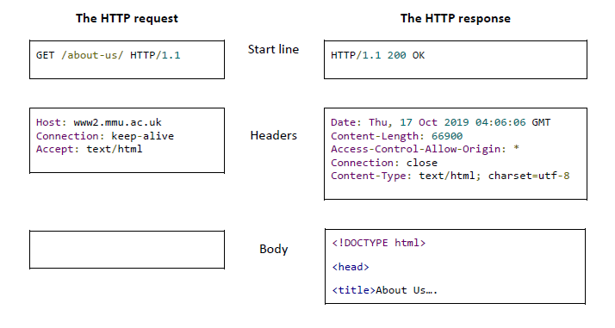
GET Request

Slide 14
Response Codes
The server sends a response code and any required data that has been requested.
Some codes that you may be familiar with:
200 Successful
404 Not Found
400 Bad Request
500 Server Error

Slide 15
Response Codes
Some codes that you may not be familiar with:
201 Created
401 Unauthorized
403 Forbidden

Slide 16
Response Codes
1xx Informational response - the request was received, continuing process
2xx Successful - the request was successfully received, understood, and accepted
3xx Redirection - further action needs to be taken in order to complete the request
4xx Client error - the request contains bad syntax or cannot be fulfilled
5xx Server error - the server failed to fulfil an apparently valid request

Slide 17
Response Codes
A list of all response codes is maintained on Wikipedia:
https://en.wikipedia.org/wiki/List_of_HTTP_status_codes
There are some strange ones, such as ‘418 I’m a teapot’ which was originally an April fool's joke.

Slide 18
POST Request
As well as GET-ting information, we sometimes want to send data
Submitting a contact us form
Logging in
Posting a status
We can do this using a POST request…

Slide 19
POST Request
POST /user HTTP/1.1
HTTP/1.1 201 Created
Host: localhost:8080
Content-Type: application/json
{ name: “Ash Williams” }

Slide 20
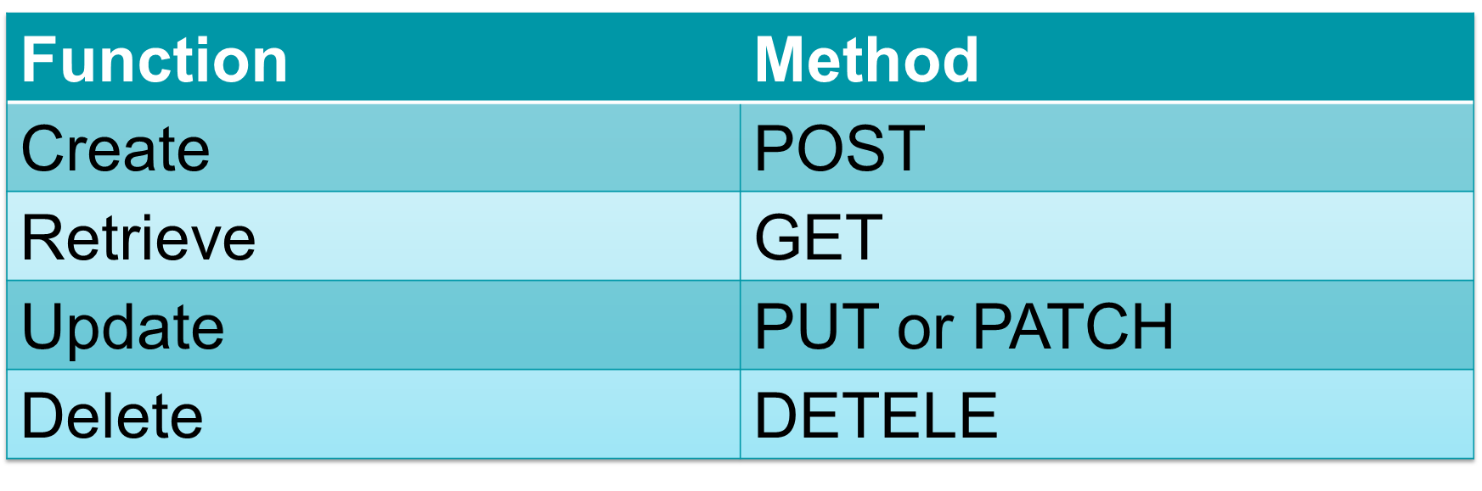
CRUD Functionality
Four functions that are considered necessary to implement a persistent storage application
We can now create and retrieve. There are also methods for updating and deleting.

Slide 21
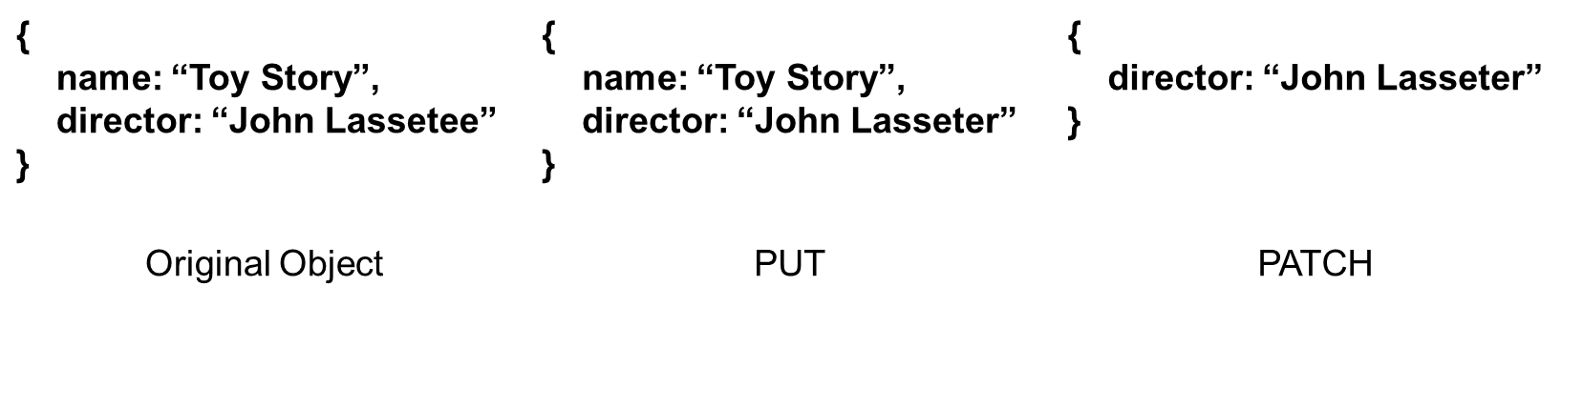
Updating
PATCH or PUT
PUT will replace the entire existing object with a new object
PATCH will update just the relevant fields

Slide 22
Delete
DELETE http://localhost:8080/user/1232456
Security has to be tight here – you don’t want to delete the wrong thing
Often some sort of verification procedure on the front end, and then resource will be achieved rather than a hard delete.

Slide 23
Worked Example
So how does this work in the real world?
Consider a movie database. We want users to be able to:
Retrieve a list of all movies
Retrieve the details of a single movie
Add a new movie to the database
Update an existing movies details
Delete a movie from the database

Slide 24
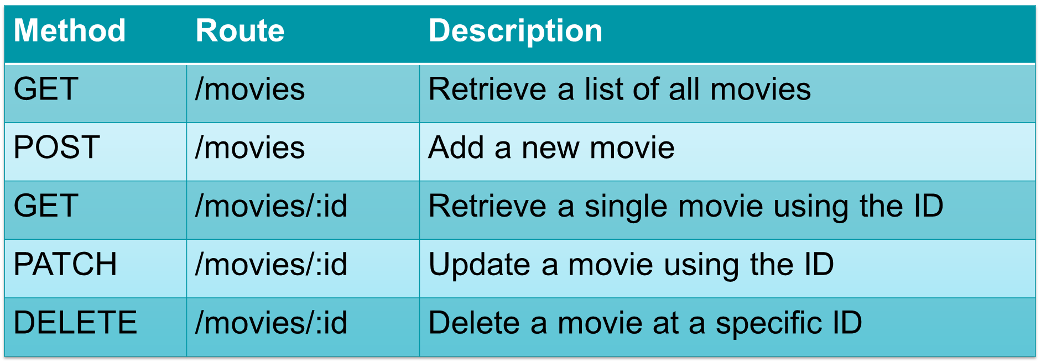
Worked Example

Slide 25
Parameters
Path Parameters
Note that some routes require the use of path parameters to identify specific resources
Query Parameters – are also a thing…
Another way of sending information to the server
Perhaps most used for filtering information that you are GET-ting.
E.g. http://google.com/search?q=hello

Slide 26
Headers
Used for sending additional information and meta-data
E.g. Content-Type: application/json (or image/jpeg, or image/png)
https://en.wikipedia.org/wiki/List_of_HTTP_header_fields

Slide 27
Security
Obviously API security is a huge deal – open interface to the world
An in depth look at security is out of the scope of this unit, but two methods are:
Limiting the methods, parameters, headers that are allowed into the system and give a default error if not allowed
E.g. 405 Method Not Allowed
Authorization tokens (API has to be stateless by definition)

Slide 28
Tools: Swagger
A tool for writing and visualising API specifications
Useful for:
Discussing with stakeholders
Designing applications
Testing workflows
Not just for documentation – you can also download the specification as a JSON file and use it in your application for verifying/validating requests. E.g. does the incoming body match the specification template. If not, then send ‘400 Bad Request

Slide 29
Demo: MovieDB in Swagger

Slide 30
Tools: Postman
An application for sending and receiving HTTP requests
Can test APIs and use Postman to ensure your understanding is correct before coding

Slide 31
Demo: Testing MovieDB with Postman

Slide 32
Making HTTP requests in JS
When would we want to make HTTP requests in a web application?

Slide 33
Making HTTP requests in JS
When would we want to make HTTP requests in a web application?
On click of a button
e.g. enter details into a login form, click submit, code sends request to the server to process the login
On page load
e.g. a user navigates to their profile, a request is made to get the profile data and recent posts to display on the page
The assignment requires both types (page load in final extension)

Slide 34
Handling HTTP in code: button clicks
First of all, what can we do already?
Create the form in HTML
Listen for a click and get the form values into JS
What’s left to do?
Send the HTTP request
Handle the HTTP response

Slide 35
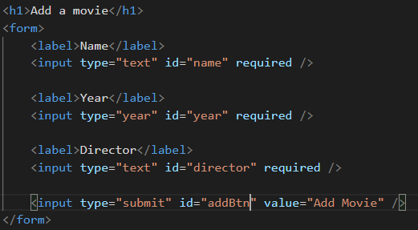
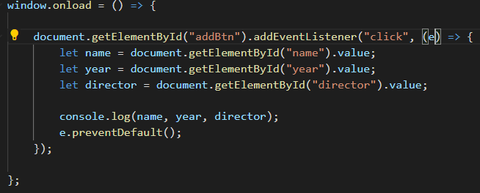
Handling HTTP in code: button clicks

Slide 36
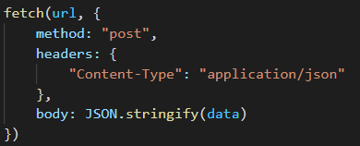
Handling HTTP in code: button clicks
Send the request using the Fetch API (built into JS)
Take in two parameters: the URL, and an object with all of the HTTP request information
Stringify the body so that it can be submitted

Slide 37
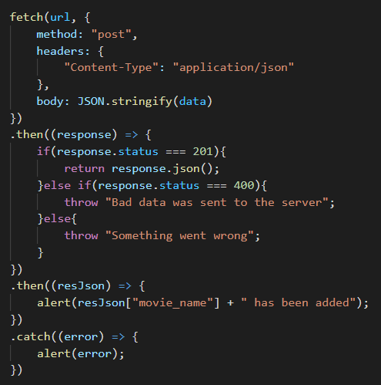
Handling HTTP in code: button clicks
The Fetch function returns a JS Promise
We will look at promises in later units, but for now just think of it as passing results into a .then() function for us to handle.
Multiple .then() functions can be chained together
We check the status code to see if the request was successful
A .catch() can be added to the end for handling errors
Very important slide for your assignment!

Slide 38
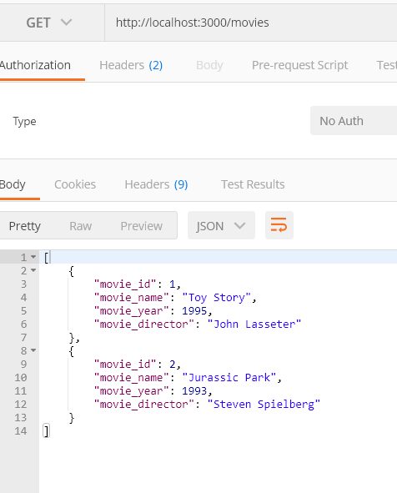
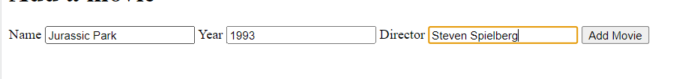
Handling HTTP in code: button clicks
Test its worked by entering a movie into the HTML form
Try some bad data and see how its handled
Try some good data and test that it has been added with Postman

Slide 39

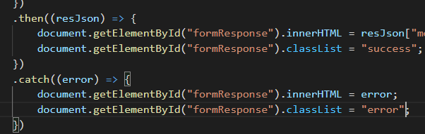
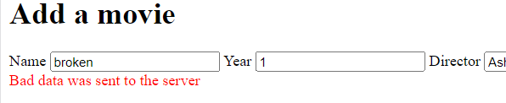
Handling HTTP in code: button clicks
Instead of ugly alert boxes, why don’t we update a div like with the validation last week…

Slide 40
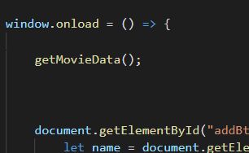
Handling HTTP in code: page loads
We are already using the window.onload function
Let’s call a function in it to load the data

Slide 41
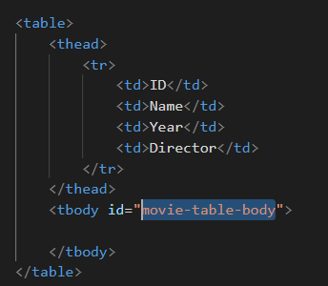
Handling HTTP in code: page loads
Before we write the function, we need somewhere for the movies to be displayed
We can create a HTML table which currently has no body
We give the body an ID so that we can use it in the JS

Slide 42
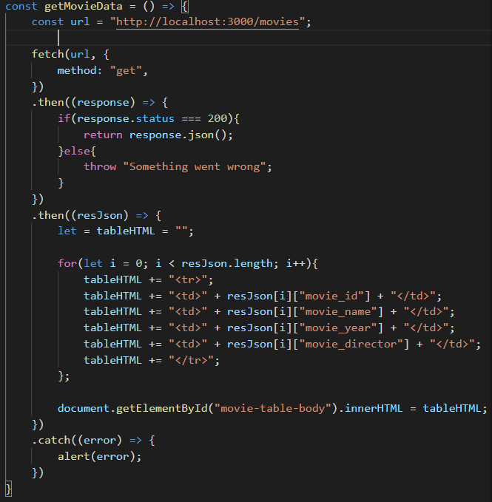
Handling HTTP in code: page loads
We use the fetch function like before
This time, it’s a GET request and we send no body
We loop through the responses to build up a string.
The string is inputted into the table to be displayed

Slide 43
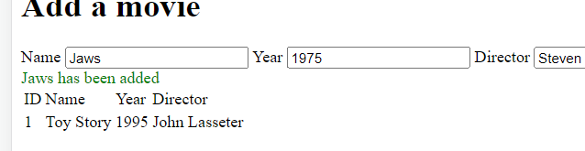
Handling HTTP in code: page loads
Test by reloading your page
One issue, when we add a movie, the table doesn’t automatically update…
How can we fix this?

Slide 44
Handling HTTP in code: page loads
Test by reloading your page
One issue, when we add a movie, the table doesn’t automatically update…
How can we fix this?

Slide 45
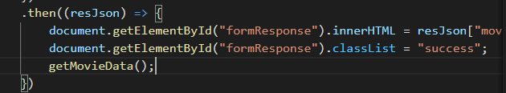
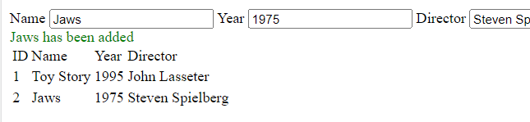
Handling HTTP in code: page loads
Simple!
Just call the getMovieData function gain when a movie is successfully added
Now we can create dynamic pages that automatically update!

Slide 46
Demo: Interact with the assignment API in Postman
Standard:
POST mudfoot.doc.stu.mmu.ac.uk/node/api/mailinglist
JSON object containing “name” and “email”
Extension:
GET mudfoot.doc.stu.mmu.ac.uk/node/api/halloffame
Query parameter “year”
On load of the page, and on form submit
“For full marks, your page should load up the data for 2021 initially, and then allow the user to change the year using the form.”

Slide 47
Alternatives to REST APIs
Out of scope for the Unit, but good to be aware of:
SOAP – Simple Object Access Protocol
Language, platform and transport independent (REST uses HTTP)
REST is easier to use and more flexible
GraphQL
One endpoint only (POST /graphql) (REST is multiple endpoints)
JSON, stateless, independent of server/front end – all like REST
Standard body (like querying a DB)

Slide 48
This week's lab
Practice interacting with REST APIs
Use JS to send and receive data using HTTP
Make progress on your assignment

Slide 49
Questions?

